Slide 1


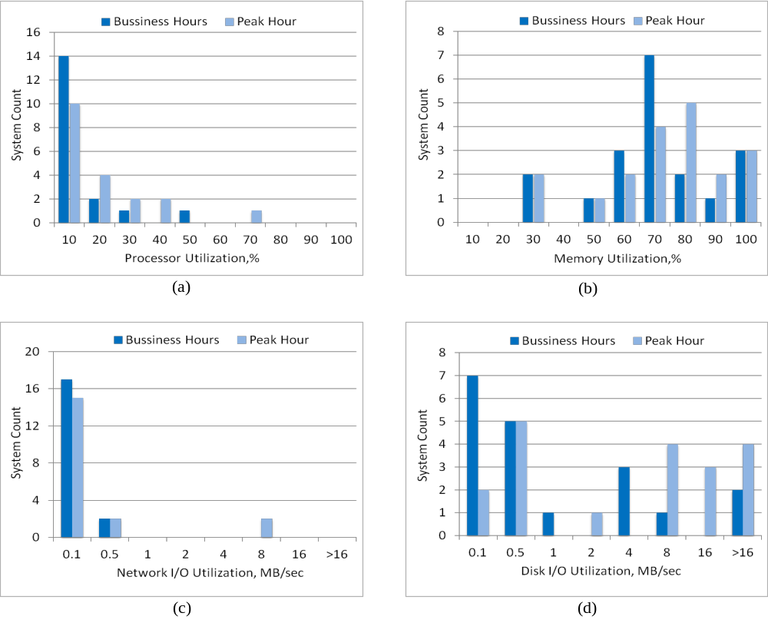
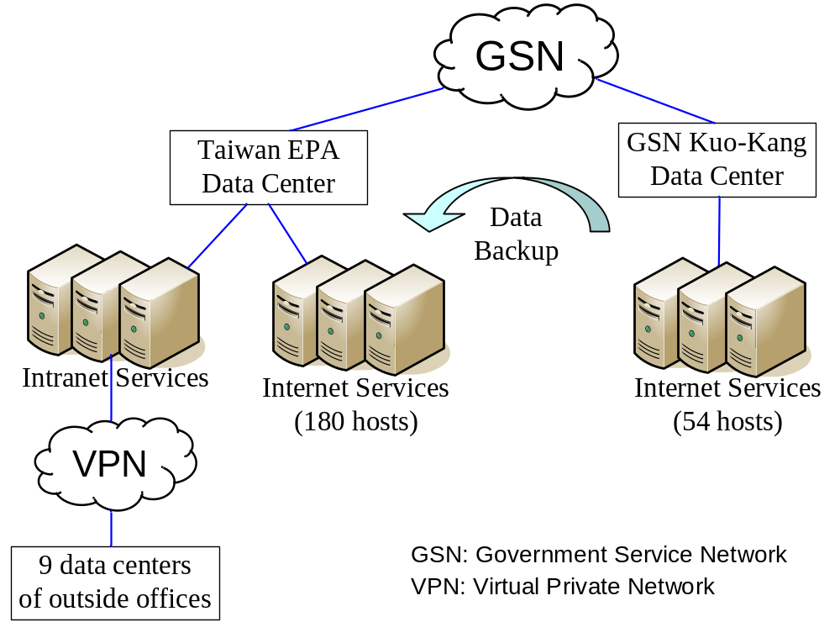
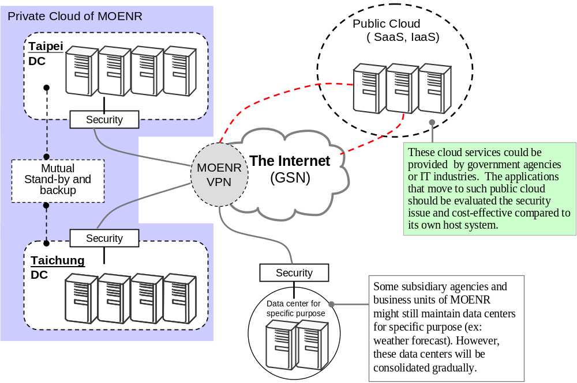
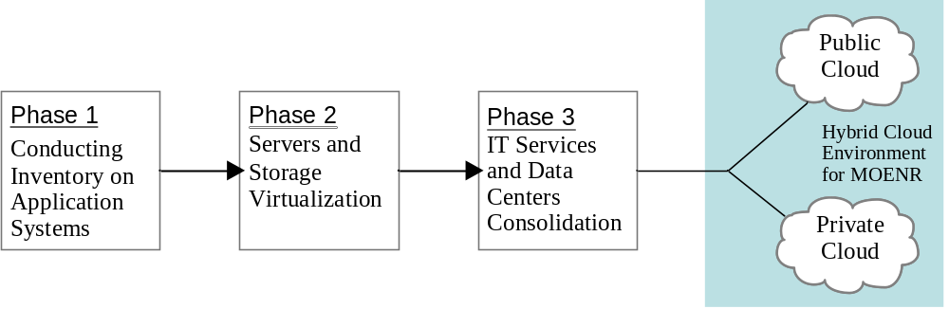
Improving Energy Performance of Data Centers
through IT Services Consolidation
Yu-Chi Chu¹, Su-Mei Huang¹, and Chi-Fu Hung²
¹Dept. Environmental Monitoring & Information Management, EPA, TAIWAN
²Dept. Information Management, Executive Yuan, TAIWAN
行政院環境保護署
Environmental Protection Administration
Executive Yuan, Taiwan, R.O.C.
Introduction
Data centers (or ICT facilities) consume huge amount of energy. According to Gartner, the the world’s leading prestigious information technology research and advisory company, data center power consumption usually is 40 times the total power consumption of the office.
Taiwan EPA used to deploy over 200 servers in 9 different data centers as shown in Figure 1. They need to budget a great deal of funds for the operation and maintenance of these data centers.
Taiwan Central Government is currently reorganizing its organization structure. Some of the agencies in charge of natural resources management such as weather, water resources and forestry will be merged with EPA to form a new ministry called Ministry of Environment and Natural Resources (MOENR). It will make a real challenge for the IT department to perform effectively to assist business units without increasing energy consumption for the new ministry.
Some of the security services are outsourced to improve public services, but it causes more cost of maintenance of the network and information security environment.
. Figure 3: The Usage of CPU, Memory, Disk and Network I/O
System Implementation
There are four stages for the implementation process: (1) Platform construction,
(2) Network infrastructure construction, (3) Application deployment, (4) Execution.
According to Taiwan EPA’s past architecture, we use server virtualization assessment tools to analyze the usage of CPU, memory, disk I/O and network I/O for each physical host.
We collected all resource usages of servers in 5 days. The results showed the average usage of CPU was 15.88%. It means low utilization rate of CPU. The average memory usage was 70.64%. The average usage of page file was 8.91%. The sum of IOPS was 5,114.79. There are 5 hosts IOPS sum was reached 4052.05, up to 80% of the other 19 servers. The average Network Bytes per second was 27646.03 bytes/sec. The Network I/O usage was down to 0.1MB or less as shown in Figure 3 (a) to (d).
. Figure 1: The Past Data Centers Architecture of Taiwan EPA
The Process toward a Hybrid Cloud Environment
We propose a systematic process, as illustrated in Figure 2, for planning the migration from traditional data centers to an energy saving data centers in association with the cloud computing approach.
Phase 1: Conducting inventory on application systems. Most organizations usually have a number of legacy systems, with a limited budget for maintaining and upgrading these systems. This involves decision making on the most appropriate strategy for evolving the systems. We adopt the common principles that have been used for legacy system management in the domain of software engineering.
Phase 2: Server and Storage Virtualization. This phase provides a solution that several virtual machines (VMs) share the same server to run instead of having their own server. Virtualization enables to reduce the overall operation cost of data centers in terms of hardware, management for facilities and space.
Phase 3: IT Services and Data Centers Consolidation. The distributed nature of Taiwan EPA’s offices (or MOENR’s offices after government reorganization) and the costs associated with long distance, high-speed network connectivity require us to balance data center consolidation with network cost and reliability factors.
The enterprise e-mail and collaboration are one of the key platforms for consolidation and cloud migration. We have moved our e-mail and some of the common services such as shared-disk space, calendar to Google Enterprise Apps beginning at January 2014. For moving those IT to public cloud, we have reduced at least ten servers.
. Figure 4: The Hybrid Cloud Framework for Taiwan EPA (MOENR in the near future)
The Benefits and Lessons Learned
Architectural advantages: Cloud computing uses innovation infrastructure which can be more effective usage of its IT hardware and software resources.
Technical advantages: Cloud computing may easily handle peak loads without additional hardware infrastructure to maintain high utilization of information resources.
Advantages for the User: the best advantage is that users no longer rely on traditional computer to develop applications, or to buy a special version of the mobile phone , PDA or other devices.
. Figure 2: The Process toward a Hybrid Cloud Environment
Contact:
Phone: +886-2-23117722 ext. 2300, 2340
Email: ycchu@epa.gov.tw, sumhuang@epa.gov.tw, hcf@ey.gov.tw
Web: http://www.epa.gov.tw
Addr: 81, Section 1, Zhonghua Rd, Taipei, 10042, Taiwan (R.O.C.)

